Slide 1

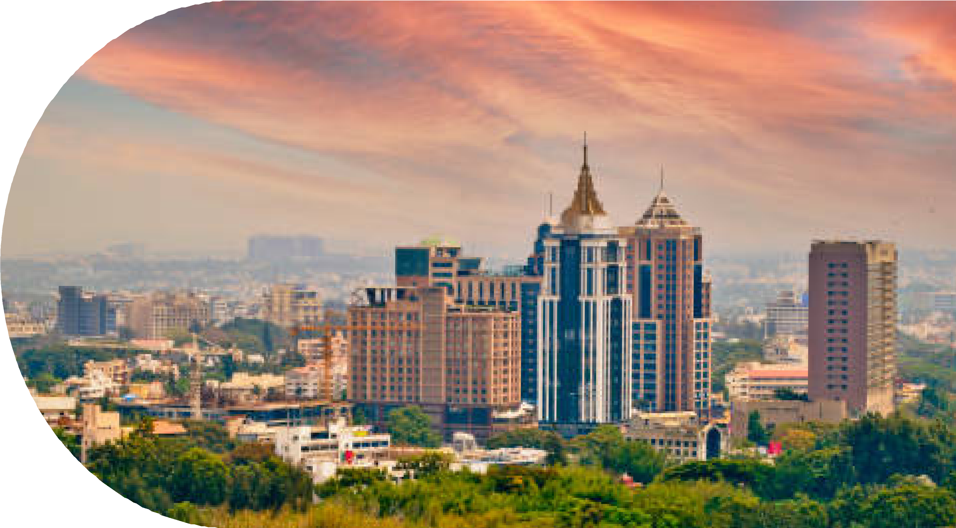

Resilient Infrastructure and Climate Adaptation
Planning for climate change impacts and building resilient urban
Infrastructure
Team - Undefined Pair
24f2002281@ds.study.iitm.ac.in 24f2008755@ds.study.iitm.ac.in

Slide 2
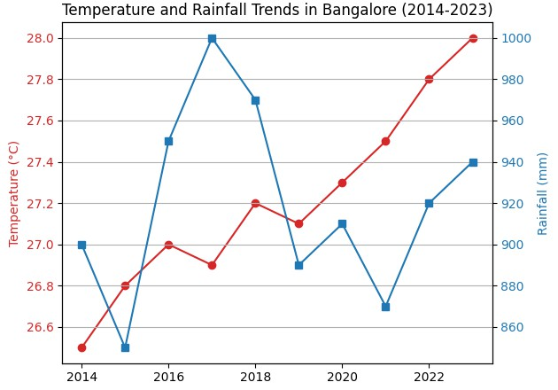
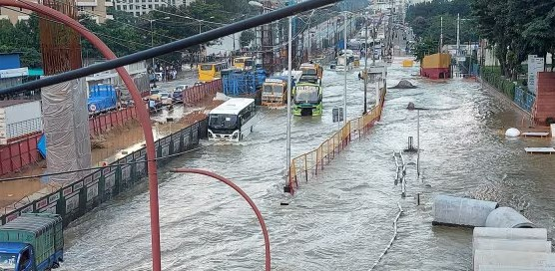


Climate Challenges in Bangalore
Understanding Bangalore’s Climate Risks
Rising temperatures and prolonged heatwaves increase energy demand.
Unpredictable monsoon patterns causing floods in areas like Bellandur and HSR Layout.
Urban infrastructure under pressure from rapid population growth.
Flood in Hebbal in 2022

Slide 3
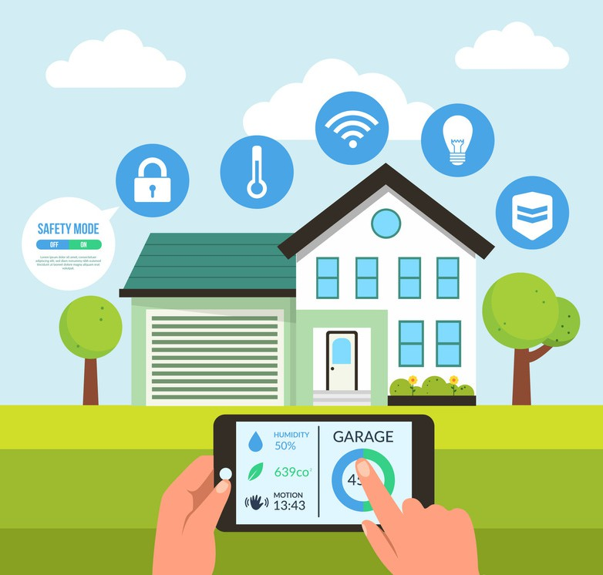
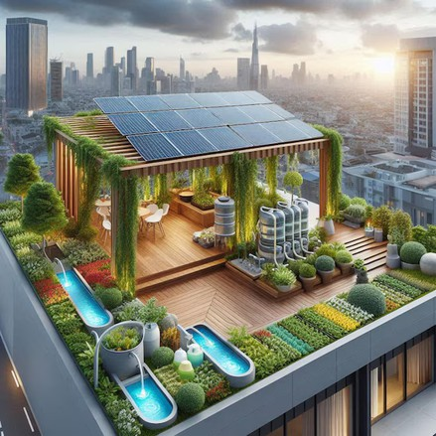
Smart Solutions for Sustainable Infrastructure
Role of Smart Devices
Energy Efficiency:
Automated curtains and lights to optimize natural light usage.
Temperature sensors for smart fan and AC control, reducing energy wastage.
Integration with Nature-Based Solutions:
Rooftop gardens with smart watering systems to save water and cool homes. Green roofs coupled with automated cooling systems to reduce urban heat.
Emergency Preparedness:
Low-power modes during power outages for essential devices.
Automated alerts for floods or extreme weather events.
Smart Device
Rooftop Gardens

Slide 4
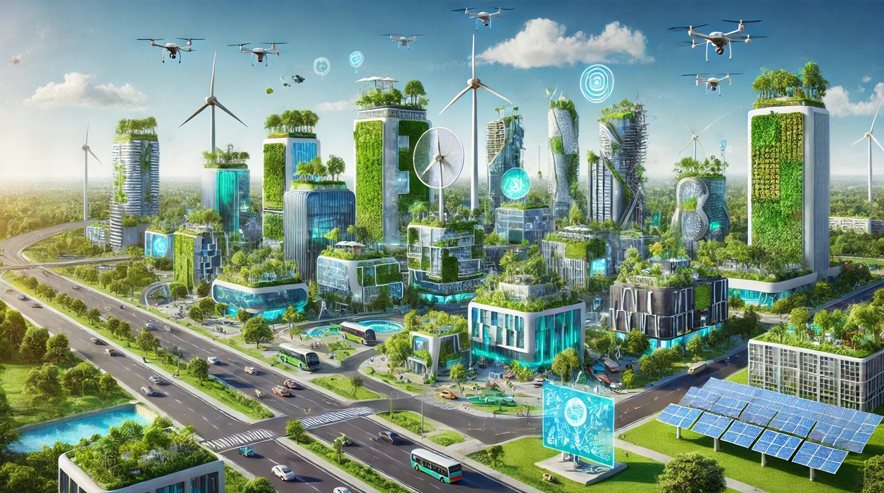
Benefits and Future Outlook
Transforming Bangalore with Smart and Sustainable Infrastructure
Benefits:
30-40% reduction in household energy bills. Enhanced resilience against climate risks (e.g., heatwaves, floods).
Improved quality of life for all residents.
Future Vision:
Expand smart solutions to public spaces and commercial areas.
Establish Bangalore as a model for sustainable urban living

